Slide 1


Web Automation project
1

Slide 2

Table of Contents
Introduction to Test Automation
Why Test Automation ?
How Selenium Work
SDLC
Project Overview & Architecture
End-to-End Testing
Reporting & Analytics
Demo Video
2

Slide 3

Introduction to Test Automation
What is Test Automation?
Definition: Process of using automation tools to execute test cases
Purpose: Reduce manual effort and increase testing efficiency
Scope: Functional, Regression, Load, and Performance testing
3

Slide 4

 | Why Test Automation ?
 | Speed: Faster time-to-market Quality: Consistent and reliable results Cost: Reduced long-term testing costs Coverage: Testing across multiple platforms Continuous Integration: Support for DevOps practices
4

Slide 5
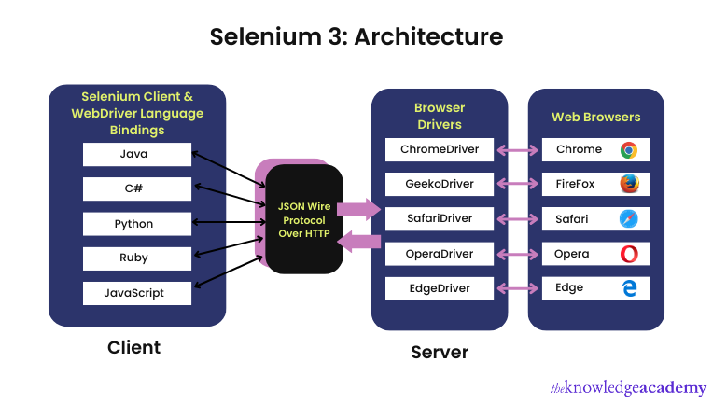
 | How Selenium Works ?
 | Test Script → WebDriver → Browser Driver → Browser → Application
5

Slide 6
Software Testing Life Cycle
(STLC)
STEP 1
STEP 2
STEP 3
Test Case Development
Requirement Analysis
Test Planning
STEP 4
STEP 5
STEP 6
Test Environment Setup
Test Execution
Test Cycle Closure
6

Slide 7



Requirement Analysis
About:
SauceDemo is a demo e-commerce website
designed to simulate a real online shopping experience.
It allows testers and QA engineers to practice
automation testing techniques.
The site includes features like user login,
product browsing, shopping cart, and checkoutprocess.
Commonly used for learning and evaluating automation tools such as Selenium, Cypress, Playwright, etc.
Title:
SauceDemo Website – Web Automation Testing Project
Website:
https://www.saucedemo.com
7

Slide 8
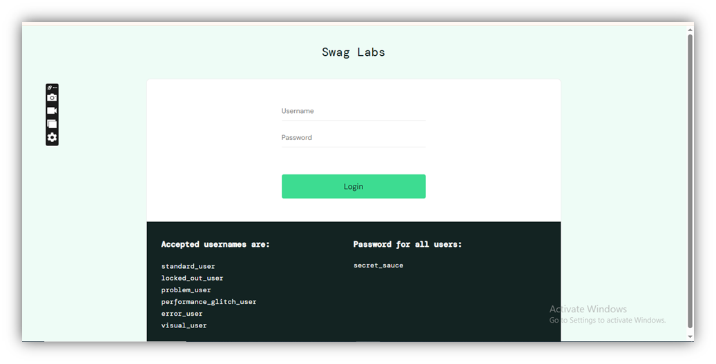
Project Objective:
Build and execute test cases for:
1. Valid and invalid
login scenarios
8

Slide 9
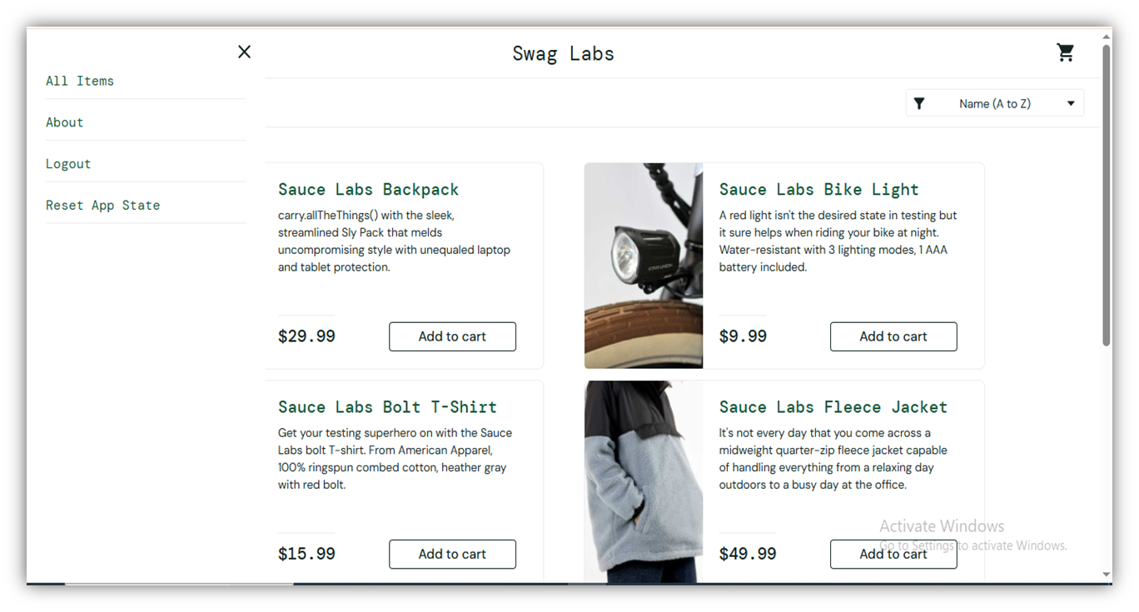
2. Product selection
9

Slide 10
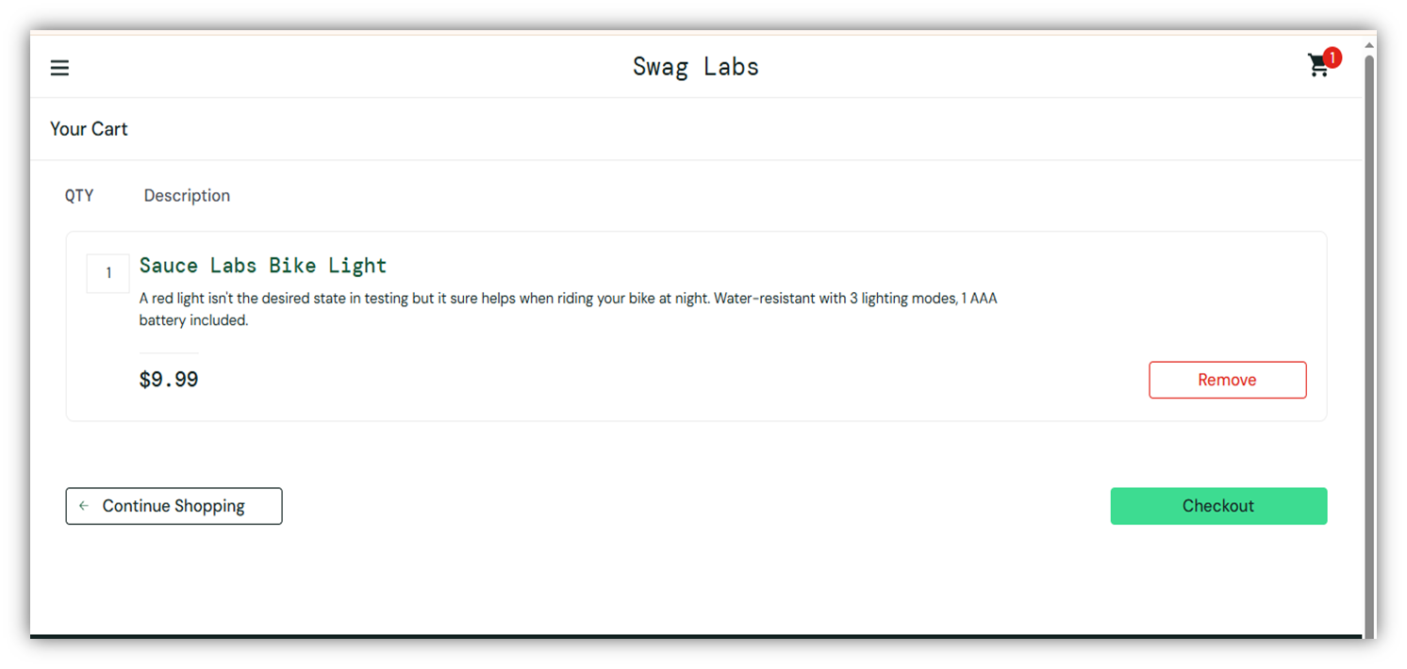
3. Cart functionality
10

Slide 11
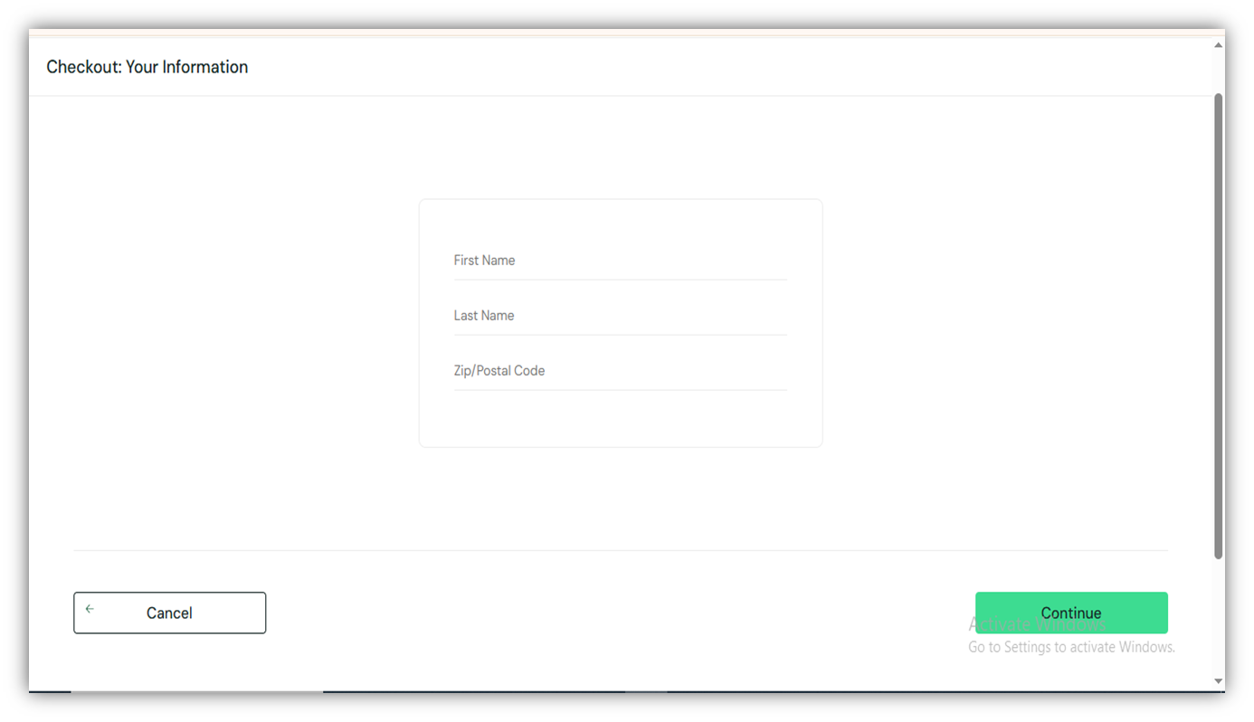
4. Checkout process (Step One)
11

Slide 12
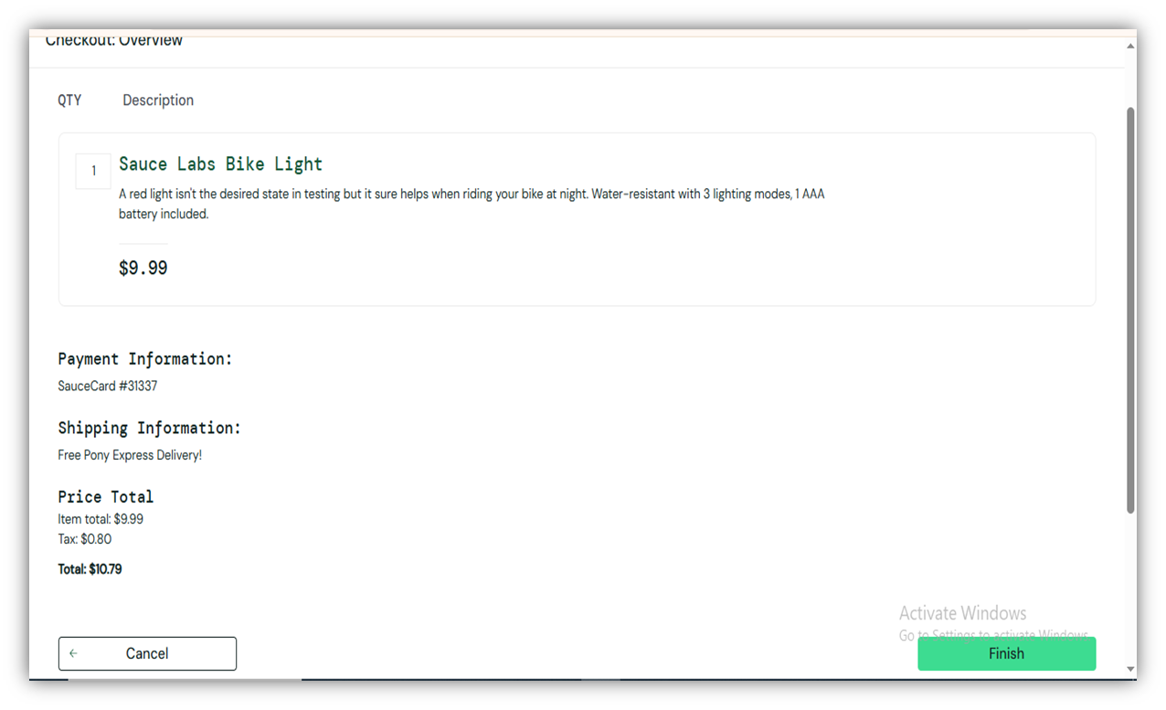
5. Checkout process (Step Two)
12

Slide 13
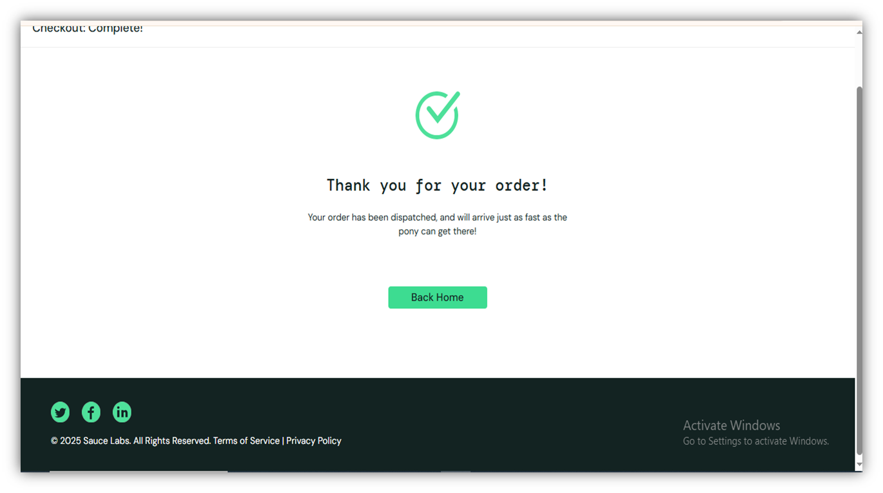
6. Checkout Completion
13

Slide 14
Test Planning
Scope:
• Login Functionality (Positive and Negative)
• Product Page – Add/Remove Items
• Cart Page – Verify items
• Checkout Process – Step One and Step Two
• Completion Page – Confirmation message
Out of Scope:
• Performance testing
• API testing
• Mobile responsiveness
• Data-Driven Testing
14

Slide 15
Tools:
• Selenium WebDriver
• Java
• TestNG
• Microsoft Edge WebDriver
Test Deliverables:
• Automation Scripts (Java)
• Test Cases (TestNG format)
• Test Execution Reports
Test Approach:
• Use Selenium WebDriver with Java and TestNG
• Apply Page Object Model (POM) for maintainability
• Execute tests on Microsoft Edge browser
• Report results by Allure report
Test Types:
• Functional Testing
• Regression Testing
• Negative Testing
15

Slide 16
Test Case Development
developed end-to-end test scenarios to
ensure that the entire user journey from logging in to
completing an order works correctly under different conditions.
16

Slide 17
Scenario 1
1.Login with Valid Credentials
2.Add Multiple Products to Cart
3.Open Cart and Verify Products are Added
4.Proceed to Checkout Step One and Fill Required Info
5.Navigate to Checkout Step Two and Finish the Order
6.Verify Order Completion Message on Checkout Complete Page
7.Click "Back Home " and Confirm Return to Inventory (Home) Page
Scenario 2
1.Login with Valid Credentials
2.Add Product to Cart and Remove It
3.Continue Shopping and Add New Item
4.Verify Cart Update
5.Proceed to Checkout with Modified Cart
6.Complete Checkout Successfully
7.Verify Order Completion Message
8.Return to Product Page
17

Slide 18
Test Execution
• Test Type: Automated Functional Testing
• Application Under Test (AUT): SauceDemo Website
• Framework Used: TestNG + Selenium WebDriver
• Programming Language: Java
• Browser Used: Chrome
• Test Execution Tool: TestNG via IntelliJ IDEA
• Operating System: Windows 11
Execution Environment: Local
18

Slide 19
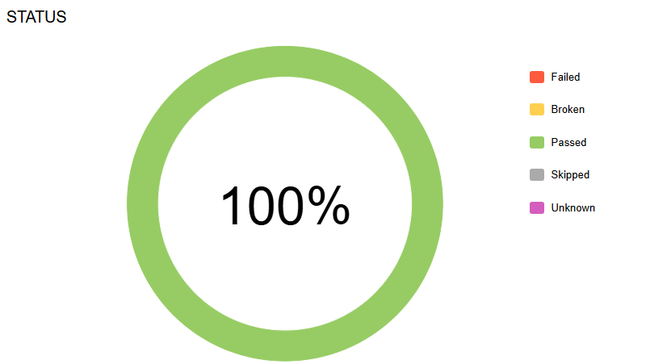
Result and Analysis
Allure Report
19

Slide 20
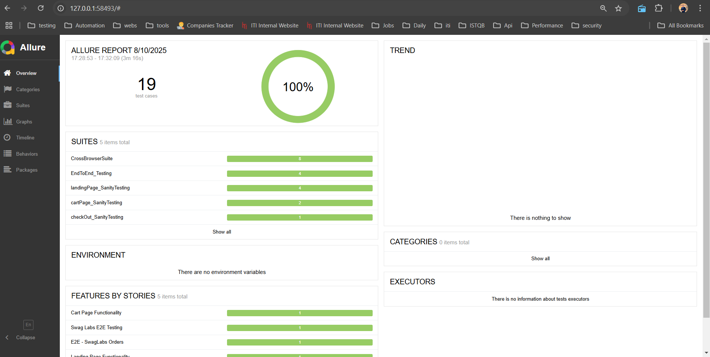
20

Slide 21
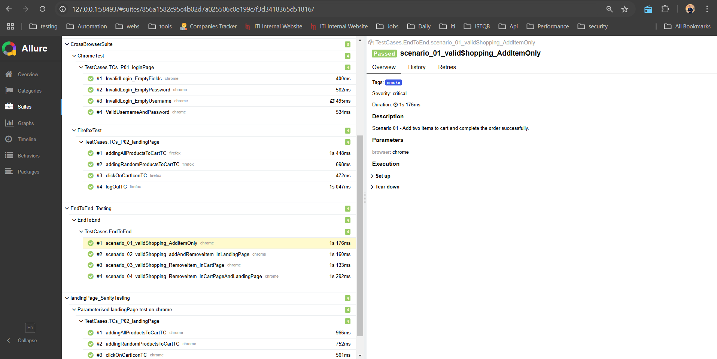
21

Slide 22
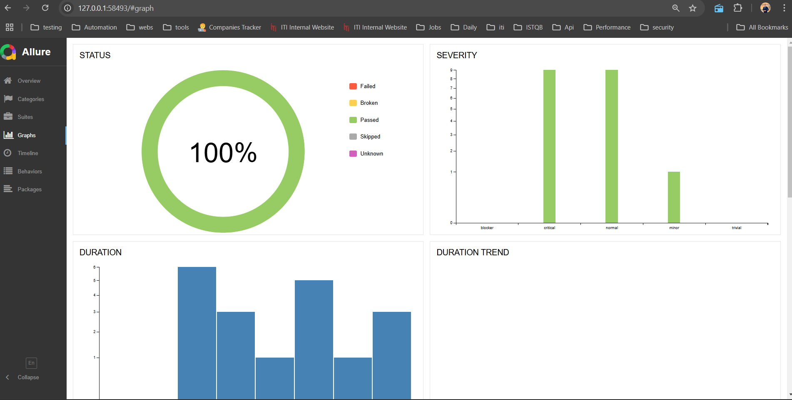
22

Slide 23
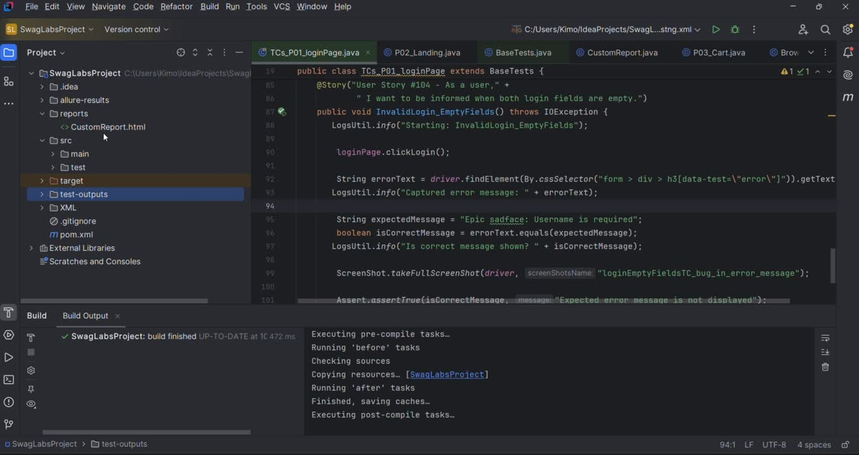
DEMO Video
23

Slide 24

Do you have any questions?
24

Slide 25
Thank you
25

